Slide 1
Sales Analysis of a Retail Chain: Big Mart
Presented by:
Kartik Amirneni
(kamirneni@horizon.csueastbay.edu)
Ashish Solanki
Muhtasin Rahman
Juili Shete
Aditya Singh Dixit
27 November 2018

Slide 2
Introduction
The data set, Big Mart Sales, was collected from the website Kaggle.com.
This data set contains sales data for 1559 different products being sold across 10 stores located in various regions throughout the year 2013.
Through data visualization(ggplot2) techniques we were able to construct narratives about the business.
We built predictive models based on linear regression and decision tree analysis so we could identify significant factors which affect sales.
These techniques can be used to further predict future sales of items by product type, location etc. and influence upcoming company marketing practices to maximize profits through higher sales.

Slide 3
Research Questions
Will items with higher visibility and greater shelf space have more sales?
Catch the eyes of customers more than items stocked less or displayed at the back of the store.
Will stores located in Tier 1 locations i.e. urban areas/cities have higher sales?
Assuming city dwellers earn higher income.
Higher population density means more customers.
Do older stores generate more sales than newer ones?
Larger, more established customer base?
Best model for predicting future sales?
Highest accuracy
Lowest error

Slide 4
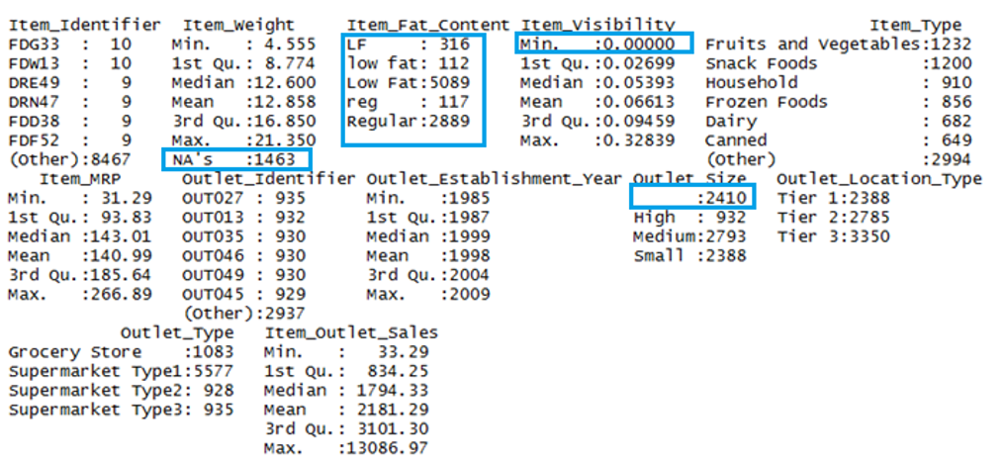
Data Cleaning and Manipulation
Imputed the missing value of Item_weight variable by median.
Converted different variations of fat to consistent values- low fat and Regular fat content.
Imputed zero(0) value of Item_visibility by median.
Used median because it is known to be highly robust to outliers.

Slide 5
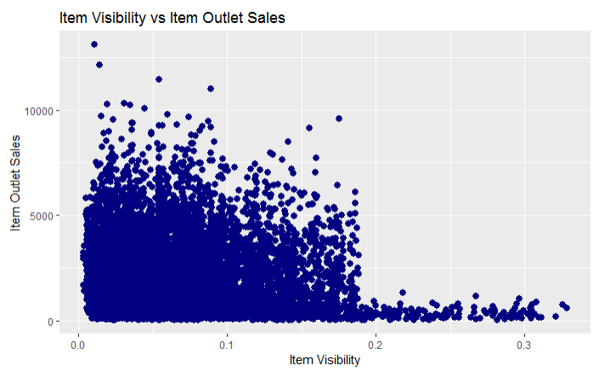
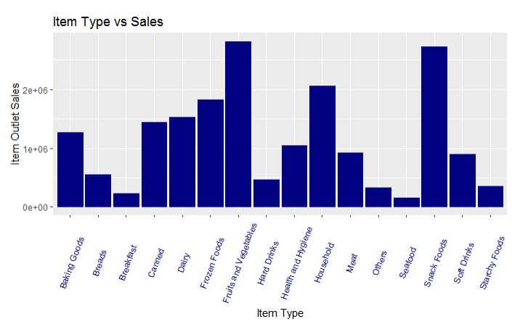
Exploratory Data Analysis
Items with 20% and lower visibility in store generated more sales
Initial hypothesis was wrong.
Customers restricting purchases to only what they need/plan to buy.
Customers’ buying habits are displayed.
Fruits and vegetables sold highest.
Followed by snack foods and then household products.
Frozen , dairy and canned foods have high sales.
As surmised, staple foods sell the most.
Hard drinks, seafood and others among lowest sellers.
Expensive and more specialized items have lower demand.

Slide 6
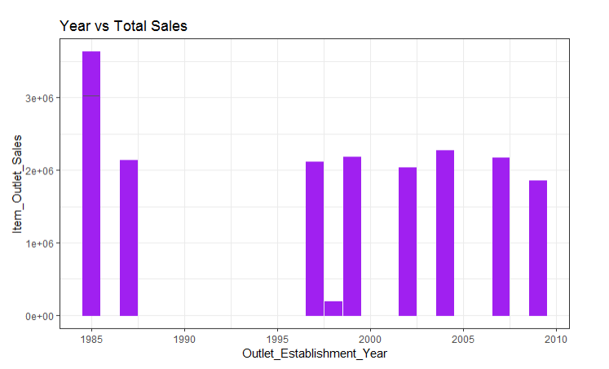
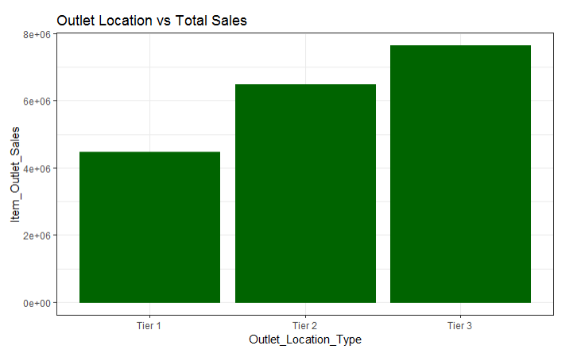
Exploratory Data Analysis
Store constructed in 1985 had highest sales.
Original hypothesis was correct.
Established, larger customer base.
Bigger size than other, newer locations
Due to earlier construction, more popular.
Other stores have similar sales except one which is significantly low.
Tier 3 (more suburban) store locations generate the most sales
Tier 1 (urban) have the least
Initial hypothesis was incorrect.
More products are being sold in Tier 3 locations.

Slide 7
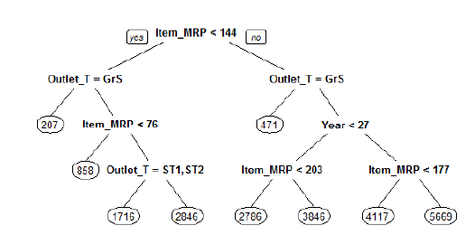
Sales Prediction
MODEL RMSE Value
Linear Regression 1018.924
Linear Regression using Log 1001.009
Decision Trees 951.4889
Thus, the Decision Trees model was able to predict sales with least error.

Slide 8
Conclusion
Data was cleaned and manipulated by imputing values.
We formulated research questions and proposed several hypotheses.
These were tested using data visualization techniques.
Major findings:
Items with 20% and lower visibility in store generated more sales
Fruits and vegetables sold highest.
Store constructed in 1985 had highest sales as they have larger customer base
Suburban (Tier 3) locations generated the most sales.
Decision tree is the most suitable prediction method with RMSE value of 951.4889.

Slide 9
THANK YOU
Questions?

